Slide 1
Optimal Route Through
65 UW Buildings
Math 480 Computer Programming for the Working Mathematician
TJ Armstrong
Bryan Clark
David Moon

Slide 2
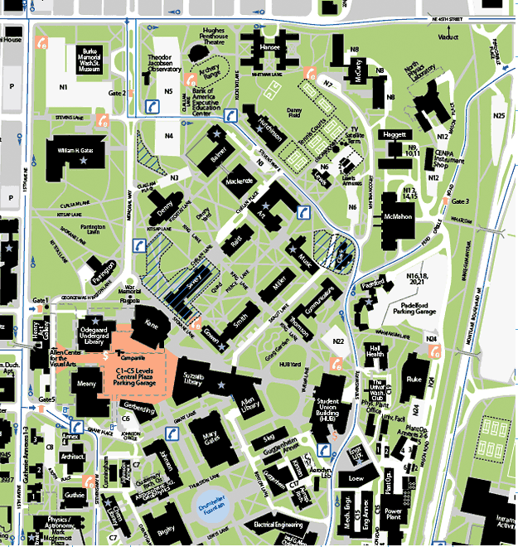
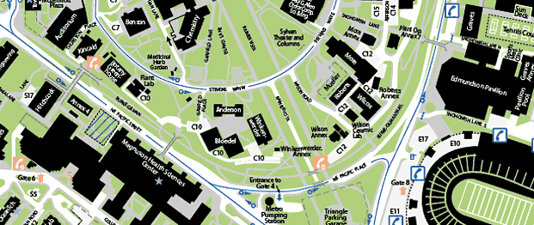
best_guess_tour:
- Total Distance = 0.08713 degrees
= 6.01658 miles
- Path: ['Burke Museum', 'Theodor J observ', 'Hansee Hall', 'McCarthy', 'North Phys Lib', 'Haggot', 'McMahon Hall', 'Padelford', 'Hall health', 'Fluke', 'UW club', 'Eng lib', 'Loew', 'Mechanical eng', 'Power plant', 'More', 'Wilcox', 'Roberts', 'Mueller', 'Forest lab', 'Bloedel', 'Anderson', 'Botany', 'Kincaid Hall', 'Physics/astronomy', 'Guthrie Hall', 'Architecture Hall', 'Meany Hall', 'Henry Art Gallery', 'Parrington', 'William H. Gates', 'Balmer Hall', 'Hutchinson', 'Lewis', 'Clark', 'Communications', 'Thompson', 'HUB', 'Kirsten', 'Aerospace research', 'Electrical eng', 'Comp Science', 'Chemistry', 'Benson Hall', 'Chem Library', 'Gerberding', 'Odegaard', 'Denny Hall', 'Mechanical eng' , 'Art', 'Music', 'Miller', 'Sieg hall', 'Guggenheim Hall', 'Bagley', 'Geology', 'Johnson Hall', 'Kane', 'Savery', 'Raitt', 'Smith', 'Gowen', 'Allen Lib', 'Mary Gates', 'Suzzallo']

Slide 3
in_order_tour:
- Total Distance = 0.21340 degrees
= 14.735062 miles
244% increase in distance from best_guess_tour
- Path: ['Bloedel', 'Forest lab', 'Anderson', 'Wilcox', 'Roberts', 'Botany', 'Mueller', 'More', 'Kincaid Hall', 'Chemistry', 'Benson Hall', 'Comp Science', 'Bagley', 'Physics/astronomy', 'Power plant', 'Electrical eng', 'Mechanical eng', 'Chem Library', 'Aerospace research', 'Geology', 'Guthrie Hall', 'Guggenheim Hall', 'Loew', 'Kirsten', 'Johnson Hall', 'Architecture Hall', 'Eng lib', 'Mary Gates', 'Sieg hall', 'HUB', 'Gerberding', 'Allen Lib', 'Meany Hall', 'UW club', 'Fluke', 'Suzzallo', 'Hall health', 'Gowen', 'Odegaard', 'Thompson', 'Henry Art Gallery', 'Smith', 'Kane', 'Communications', 'Padelford', 'Savery', 'Miller', 'Parrington', 'Music', 'Clark', 'Raitt', 'McMahon Hall', 'Denny Hall', 'Art', 'Mackenzie Hall', 'Lewis', 'Balmer Hall', 'William H. Gates', 'Haggot', 'Hutchinson', 'North Phys Lib', 'Theodor J observ', 'McCarthy', 'Burke Museum', 'Hansee Hall']

Slide 4
closest_point_tour:
- Total Distance = 0.08038 degrees
= 5.54991 miles
8% decrease in in distance from best_guess_tour
- Path: ['William H. Gates', 'Burke Museum', 'Theodor J observ', 'Balmer Hall', 'Mackenzie Hall', 'Art', 'Raitt', 'Miller', 'Music', 'Communications', 'Thompson', 'Smith', 'Gowen', 'Suzzallo', 'Kane', 'Savery', 'Denny Hall', 'Parrington', 'Odegaard', 'Meany Hall', 'Architecture Hall', 'Guthrie Hall', 'Physics/astronomy', 'Kincaid Hall', 'Botany', 'Benson Hall', 'Bagley', 'Geology', 'Johnson Hall', 'Gerberding', 'Chem Library', 'Chemistry', 'Anderson', 'Bloedel', 'Forest lab', 'Mueller', 'Roberts', 'More', 'Wilcox', 'Mechanical eng', 'Loew', 'Eng lib', 'HUB', 'Kirsten', 'Aerospace research', 'Electrical eng', 'Comp Science', 'Guggenheim Hall', 'Sieg hall', 'Allen Lib', 'Mary Gates', 'UW club', 'Hall health', 'Fluke', 'Padelford', 'Clark', 'McMahon Hall', 'Haggot', 'North Phys Lib', 'McCarthy', 'Lewis', 'Hutchinson', 'Hansee Hall', 'Henry Art Gallery', 'Power plant']

Slide 5
shortest_closest_point_tour:
-Total Distance = 0.07017 degrees
= 4.84556 miles
20% decrease in distance from best_guess_tour
-Path: ['Forest lab', 'Anderson', 'Bloedel', 'Chemistry', 'Bagley', 'Geology', 'Johnson Hall', 'Gerberding', 'Meany Hall', 'Odegaard', 'Parrington', 'Kane', 'Savery', 'Gowen', 'Smith', 'Miller', 'Music', 'Communications', 'Thompson', 'HUB', 'Eng lib', 'Loew', 'Mechanical eng', 'Power plant', 'More', 'Roberts', 'Mueller', 'Wilcox', 'Comp Science', 'Electrical eng', 'Guggenheim Hall', 'Kirsten', 'Aerospace research', 'Sieg hall', 'Allen Lib', 'Mary Gates', 'Suzzallo', 'Raitt', 'Mackenzie Hall', 'Balmer Hall', 'Hutchinson', 'Art', 'Lewis', 'Clark', 'Padelford', 'Hall health', 'UW club', 'Fluke', 'McMahon Hall', 'Haggot', 'North Phys Lib', 'McCarthy', 'Hansee Hall', 'Theodor J observ', 'Burke Museum', 'William H. Gates', 'Denny Hall', 'Henry Art Gallery', 'Architecture Hall', 'Guthrie Hall', 'Physics/astronomy', 'Kincaid Hall', 'Botany', 'Benson Hall', 'Chem Library']

Slide 6
opt_edge_tour:
-Total Distance = 0.06665 degrees
= 4.60266 miles
24% decrease in distance from best_guess_tour
-Path: ['Forest lab', 'Anderson', 'Bloedel', 'Chemistry', 'Bagley', 'Geology', 'Johnson Hall', 'Gerberding', 'Meany Hall', 'Odegaard', 'Kane', 'Savery', 'Gowen', 'Suzzallo', 'Mary Gates', 'Allen Lib', 'Sieg hall', 'Guggenheim Hall', 'Kirsten', 'Aerospace research', 'Electrical eng', 'Comp Science', 'Mueller', 'Roberts', 'Wilcox', 'More', 'Power plant', 'Mechanical eng', 'Loew', 'Eng lib', 'HUB', 'Thompson', 'Communications', 'Music', 'Miller', 'Smith', 'Raitt', 'Mackenzie Hall', 'Balmer Hall', 'Hutchinson', 'Art', 'Lewis', 'Clark', 'Padelford', 'Hall health', 'UW club', 'Fluke', 'McMahon Hall', 'Haggot', 'North Phys Lib', 'McCarthy', 'Hansee Hall', 'Theodor J observ', 'Burke Museum', 'William H. Gates', 'Denny Hall','Parrington', 'Henry Art Gallery', 'Architecture Hall', 'Guthrie Hall', 'Physics/astronomy', 'Kincaid Hall', 'Botany', 'Benson Hall', 'Chem Library']

Slide 7
Sage Worksheet
http://www.sagenb.org/home/brclark17/3/

