Slide 1
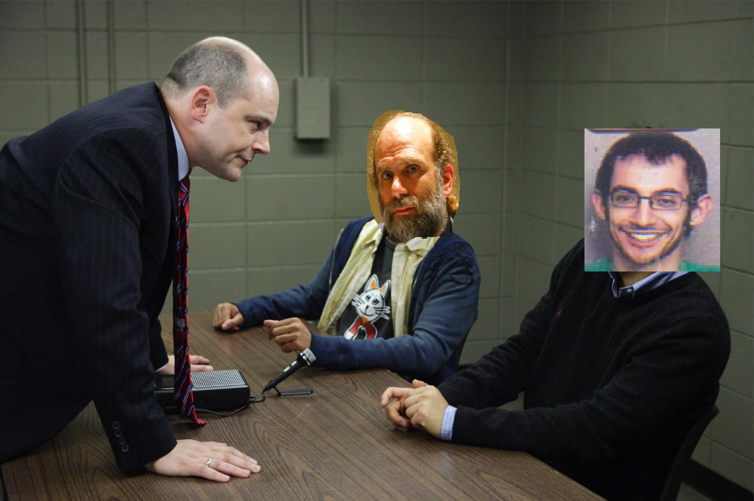

Slide 2
The Possibility of a Back Door in the NIST SP800-90 Dual Ec Prng
Dan Shumow
University of Washington Department of Mathematics

Slide 3
Introduction
NIST SP800-90 introduced a Cryptographic PRNG with prediction and backtracking resistance supposedly equivalent to breaking Elliptic Curve Cryptosystems. i.e. “Provably Secure”
The academic community has several objections to this algorithm.
This presentation shows how the algorithm could possibly contain a secret backdoor (possibly intentionally.)

Slide 4
The Controversy
This attack was first shown at Crypto 2007.
In a blog posting, Bruce Schneier revealed that the algorithm was actually written by NSA employees.
The story was slashdotted and the NSA looked (even more) evil to the (already conspiracy theory prone) slashdot audience.

Slide 5
Preliminaries:
Cryptographic PRNGS
To do cryptography one needs a source of secure numbers that other people cannot guess.
Applications: Generating Keys, Signing, Security Protocols
In principal this is very hard.

Slide 6
Preliminaries:
Cryptographic PRNGS
To do cryptography one needs a source of secure numbers that other people cannot guess.
Applications: Generating Keys, Signing, Security Protocols
In principal this is very hard.

Slide 7
Preliminaries:
Elliptic Curves
Elliptic curves are the set of points (x,y) with coordinates in a field F that are solutions to an equation:
y² = x³ + ax + b
These points (plus an identity) form a group.
All of the curves that we will be discussing are over finite fields (characteristic p) and will have prime order q.

Slide 8
The Dual Ec PRNG
φ : prime curve → integers
φ (x,y) = x
P, Q points on the curve (per SP800-90)
φ(r_{i}*P)
s_{i+1}
s_{i}
r_{i}
φ(r_{i}*Q)
t_{i}
LSB_{bitlen-16}(t_{i})
Equations:
r_{i} = φ(s_{i}*P) t_{i} = φ(r_{i}*Q) s_{i+1} = φ(r_{i}*P)

Slide 9
Intuition Behind the
“Provable Security”
You cannot get the internal state r_{i} without inverting the operation
t_{i} = r_{i}*Q
So recovering the internal state is tantamount to inverting a point multiplication.
Inverting EC point multiplication is the hard problem in ECC.

Slide 10
Intuition Behind the
“Provable Security”
Backtracking Resistance:
You cannot get a previous output without a previous state. And you cannot get a previous internal state without inverting a point multiplication r_{i} = r_{i-1}*P

Slide 11
Intuition Behind the
“Provable Security”
Prediction Resistance:
You cannot get a subsequent output without the subsequent internal state, and you cannot get a subsequent internal state without the present internal state.

Slide 12
The Objection
Point P is generator of the curve (per SP800-90).
Point Q is a specified constant. It is not stated how it was derived.
NIST prime curves have prime order. So there exists e such that e*Q = P. (basic fact from group theory.)
Anyone who knows e can recover the internal state of the PRNG

Slide 13
The Attack
Output: S, the set of possible values of s_{i+1} the internal state of the Dual Ec PRNG at the subsequent step.
Suppose an attacker knows value e.
  Given: a block of output o_{i} from a Dual EC PRNG Instance
  Set S = {}.
  For 0 ≤ u ≤ 2¹⁶ −1
  x = u|o_{i}
  z ≡ x³ + ax + b mod p.
  If y ≡ z^{1/2} mod p exists => A = (x,y) is on the curve
  S = S U {φ(e*A)}.

Slide 14
How this works:
One of the values x = t_{i}
If A is the point with x coordinate t_{i} then:
A = r_{i} * Q
Thus:
φ(e*A) = φ(e* r_{i} * Q) = φ(r_{i} * P) = s_{i+1}.
=> s_{i+1} is in S.
|S| ≈ 2¹⁵

Slide 15
Experimental Verification
Use NIST P-256 Curve
Chose random d
Chose Q₂ = d*P
Replace Q with Q₂
Given |Output| = 32 > 1 output block length (the length of a TLS client/server random)
With each possible state, run the PRNG for one block and filter out all s_{i+1} values that do not correspond to the next 2 bytes of output.

Slide 16
Experimental Verification
In every experiment 32 bytes of output was sufficient to uniquely identify the internal state of the PRNG.
If an attacker knows the value e, 32 bytes of output can significantly reduce the set of possible internal states to just a few.
One SSL/TLS connection is sufficient to identify a small number of possibilities for the internal state of this PRNG.

Slide 17
The Main Point
If an attacker knows d such that d*P = Q
then they can easily compute e such that
e*Q = P (invert mod group order)
If an attacker knows e then they can determine a small number of possibilities for the internal state of the Dual Ec PRNG and predict future outputs.
We do not know how the point Q was chosen, so we don’t know if the algorithm designer knows d or e.

Slide 18
Technical Conclusion
WHAT WE ARE NOT SAYING:
NIST (or NSA) intentionally put a back door in this PRNG (no matter what Bruce Schneier says.)
WHAT WE ARE SAYING:
The prediction resistance of this PRNG (as presented in NIST SP800-90) is dependent on solving one instance of the elliptic curve discrete log problem.
(And we do not know if the algorithm designer knew this before hand.)

Slide 19
Other Objections
No one actually bothered to provide a security proof of this algorithm (that is why it is not true.)
There is a security proof (given after the fact) but it is not a tight reduction (i.e. it is a probabilistic reduction) [Gjosteen et al]
The truncation of 16 bits is too little, and the output bit stream has a statistical bias [Schoenmakers et al.]

Slide 20
Suggestions for Improvement
Truncate off more than the top 16 bits of the output block.
  Results on extractors from x coordinates of EC points of prime curves suggest truncating off the top bitlen/2 bits is reasonable.
Generate a random point Q for each instance of the PRNG.

Slide 21
The Big Question:
Is this intentional?
The algorithm designers could quickly dispel doubts by disclosing how the point Q was generated
(there are secure point generation schemes.)
It is possible

Slide 22
Possible but Improbable
I found this, and I am neither a talented mathematician nor a talented cryptographer. I was just the first person to commercially implement the algorithm.
The probability of getting caught trying to sneak this in is too high.
Neither NIST nor the NSA told anyone to use this (it is not the Clipper Chip.)

Slide 23
What we can really Conclude
Bloggers will blow things out of proportion to get attention.
Slashdot starts more conspiracy theories than Chris Carter.
The NSA is not the cryptographic research power house it once was.
Eventually open academic communities will surpass closed shops.

